Slide 1
Scripting
Tutorial #3

Slide 2
OBJECTIVE

Slide 3
Objective
This tutorial introduces you to Javascript and the structure of writing code.

Slide 4
TEXTPLANATION

Slide 5
Textplanation
So....scripting. More importantly, Javascript. That’s the language of choice for scripting web pages. Why do we need it, you ask? Because, without the script, your page would have no way to interact with your user. You could put nice static text and even images and videos on your page, but the person on the other side of the screen wouldn't be able to do anything but sit and watch...and maybe drool.

Slide 6
Textplanation
So. Scripting. While Javascript has no real relationship to Java, a lot of the syntax is the same. You'll learn that by doing it, but there are a few musts, you should be aware of.

Slide 7
Textplanation
The semicolon is a big one. It’s punctuation for Javascript. Whenever you complete a statement, you put a semicolon at the end.

Slide 8
Textplanation
Organization is another biggie. You’d be surprised just how easy it is to let the code write itself. Except, the code does a terrible job writing itself. Make sure you are in control of your code from top to bottom.

Slide 9
Textplanation
You will have to debug your code. In fact, you should be resigned to the fact that you will spend way more time debugging than you will actually writing code in the first place.

Slide 10
Textplanation
Make sure you know which parts of your code are supposed to execute and when. If you don't know why you put a piece of code where you put it, then it’s a pretty safe bet that that piece of code is not doing what you thought it was supposed to do.

Slide 11
CONSTRUCTION

Slide 12
Construction
Create a folder somewhere on your drive and label it First Script.
Open up notepad++.
Save the empty file to your folder and name the file “index.html”.
All first pages on a website are called index.
As you go through the images of the construction, add to your code. You will see comments with explanations of what you are doing. Those comments will change with each slide. You should not type my comments into your code.

Slide 13
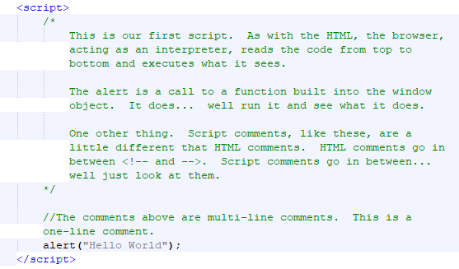
Construction

Slide 14
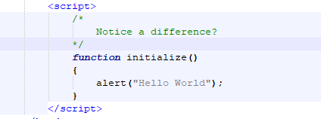
Construction

Slide 15
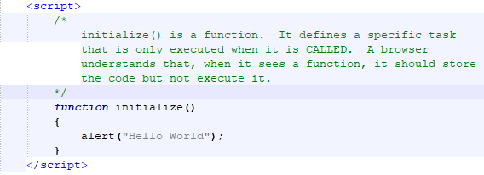
Construction

Slide 16
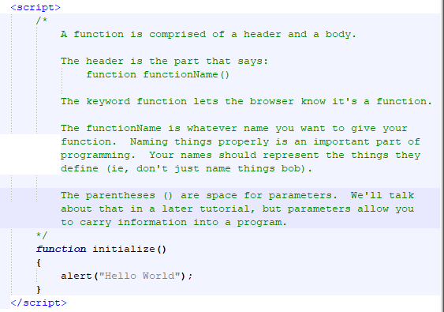
Construction

Slide 17
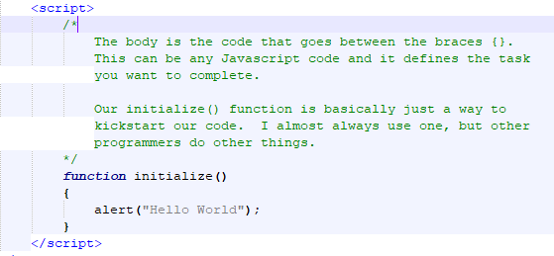
Construction

Slide 18
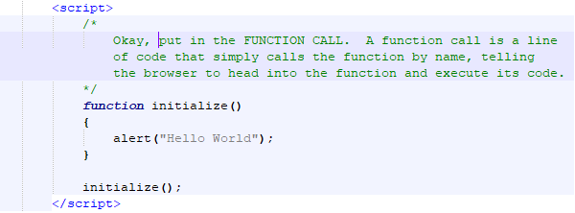
Construction

Slide 19
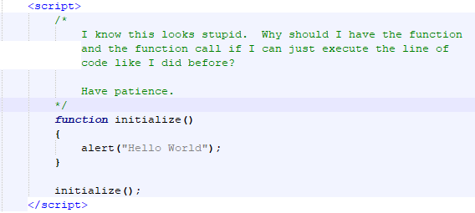
Construction

Slide 20
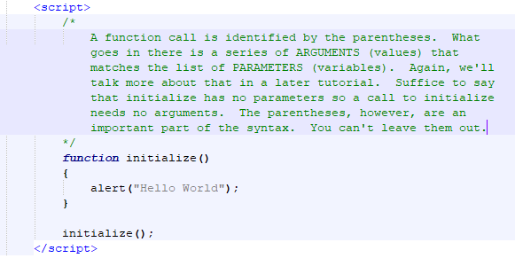
Construction

Slide 21
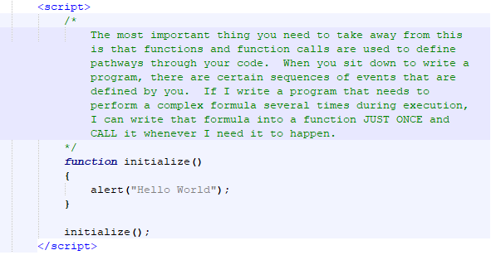
Construction

Slide 22
A DEEPER MEANING

Slide 23
A Deeper Meaning
When you're working with an HTML document, you're working with virtual objects. Javascript gives you a way to manipulate those objects.
Think about the alert we used.
What is alert?

Slide 24
A Deeper Meaning
alert(...) is a function call. Notice the parentheses? The question is, if alert(...) is a function call, where is the function? That function belongs to the window object. We didn't write it. We never see it. We just get to use it.

Slide 25
A Deeper Meaning
The "Hello World" portion of the call is an argument. We are passing a string value into the alert(...) function which tells it what to put into the popup box. The alert(...) function has a parameter (variable) ready to receive. If you're not fully understanding this concept, read it again. If you still don't understand it, then don't worry too much. There's a whole tutorial on it.

Slide 26
A Deeper Meaning
The Document Object Model (DOM) has a hierarchy of objects. At the top of that hierarchy is the window (yes, even on a Mac). Inside the window is your document and inside your document is everything else. Every object, from the window on down, has properties and functions that belong to it. Some of the properties that belong to the window are its height and width. One of the functions is alert. What we did was make a function call to alert inside the window.

Slide 27
FAQ

Slide 28
FAQ
What is an object?
An object is a thing. Really. That's all. A pencil, a book, a car, your head...they're all objects. They all have properties like size and shape and color, and they all have things that they can do like write and drive and think. The only difference between those objects and the ones we program with is that the computer objects are virtual.

Slide 29
FAQ
Why does my code work, even if I leave out the semicolons?
The short answer is because browsers are stupid. They're not programmed to look too deeply at the code’s structure. If they can recognize and execute a line of code, they will. You should be aware, however, that there are situations where that semicolon is absolutely essential. Without it, your program will crash and burn.

Slide 30
ACTIVITY

Slide 31
onload
In order to organize your page using functions, which I strongly recommend, you need to tell your page to trigger the initialize function right away. Follow the instructions to modify your code. Then, comment your code, explaining as best as you can, what the new code does and how it does it

Slide 32
onload
Do not look up the explanation online. This is an exercise for you to try and figure out how something works. Over the lifetime of your programming career, you're going to often try to work from samples of code which do things you've never seen before. The ability to understand and document what thay code does just by reading it and applying prior knowledge and a little bit of common sense will go a long way toward accelerating your progression.

Slide 33
onload
Remove the function call to initialize.
Change your body tag so that it looks like this:
Run the page.
Document your observation and hypothesis by commenting the code. Don't worry about being right or wrong. As long as there’s a reason for what you think, it’s an important analysis.

